Slide 1
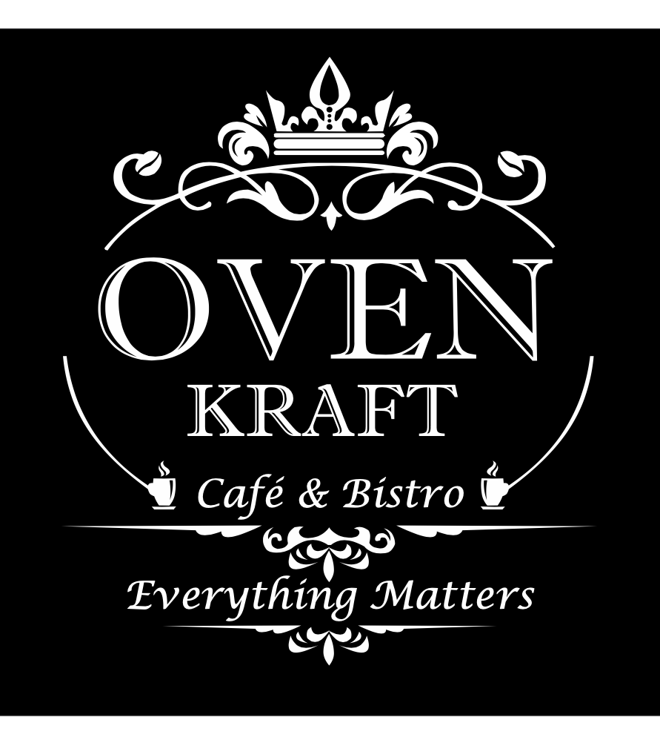
COMPLETE MARKETING STRATEGY & RESTRUCTURING TO CAFÉ RESTURANT BUSINESS
PREPARED BY
BHAGYASHREE CHAVAN
PREPARED FOR
DS 680 MARKETING ANALYSTICS CLASS(MOHIT SUPE)

Slide 2
CONTENTS
EXECUTIVE SUMMERY
OBJECTIVE & SCOPE
CONCLUSION
MARKET ANALYSIS
MARKETING STRATEGIES
FINANCIAL FORMATIONS
PROJECT METHODOLOGY & DELIVERABLES
COMPETITOR ANALYSIS

Slide 3
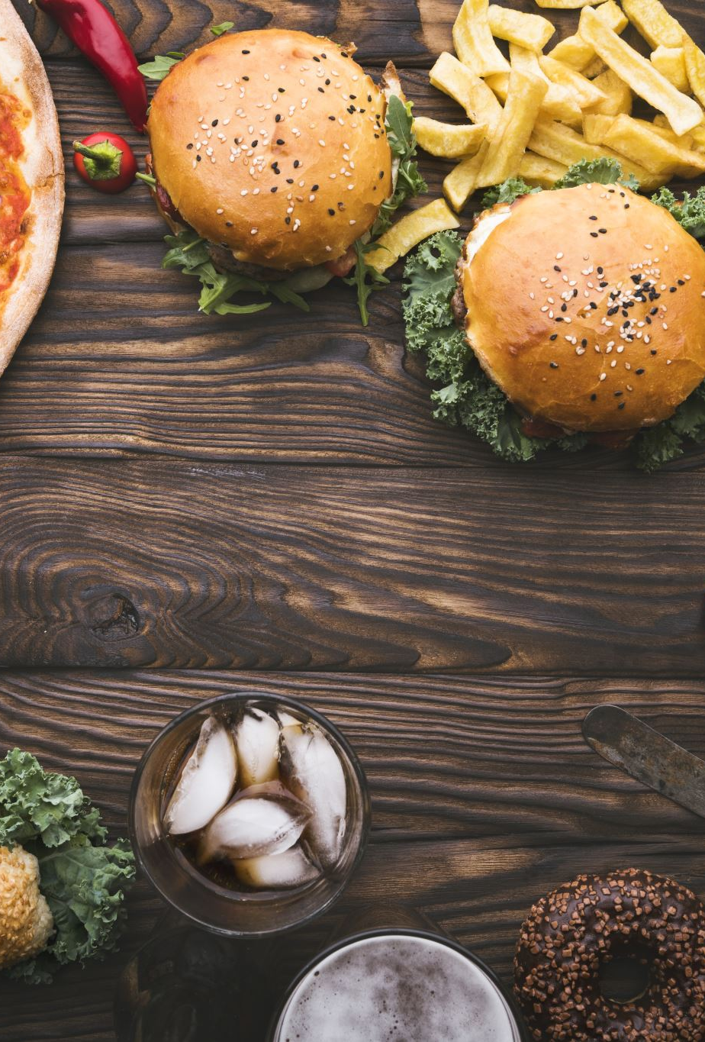
EXECUTIVE SUMMERY
Oven Kraft was incorporated in 2018 by a Mid level investors group.
Restaurant is café and bistro based in Navi Mumbai which had a fast-food facility with fine dine.
Company sell multiple fast-food products with hot and cold beverages.
The company is state of reentering into market with the vision of further expanding into a completely functional mode.

Slide 4
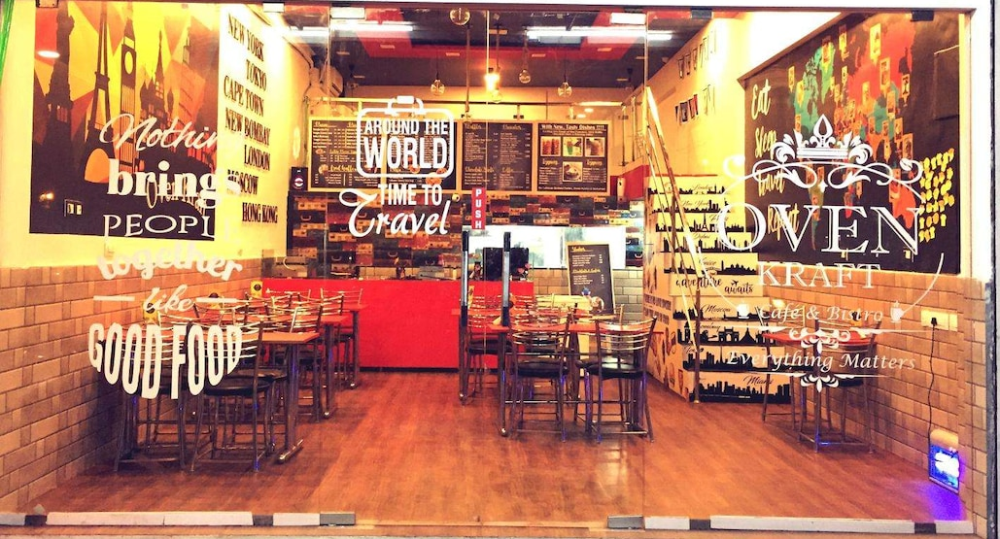
Oven Kraft Café Restaurant

Slide 5
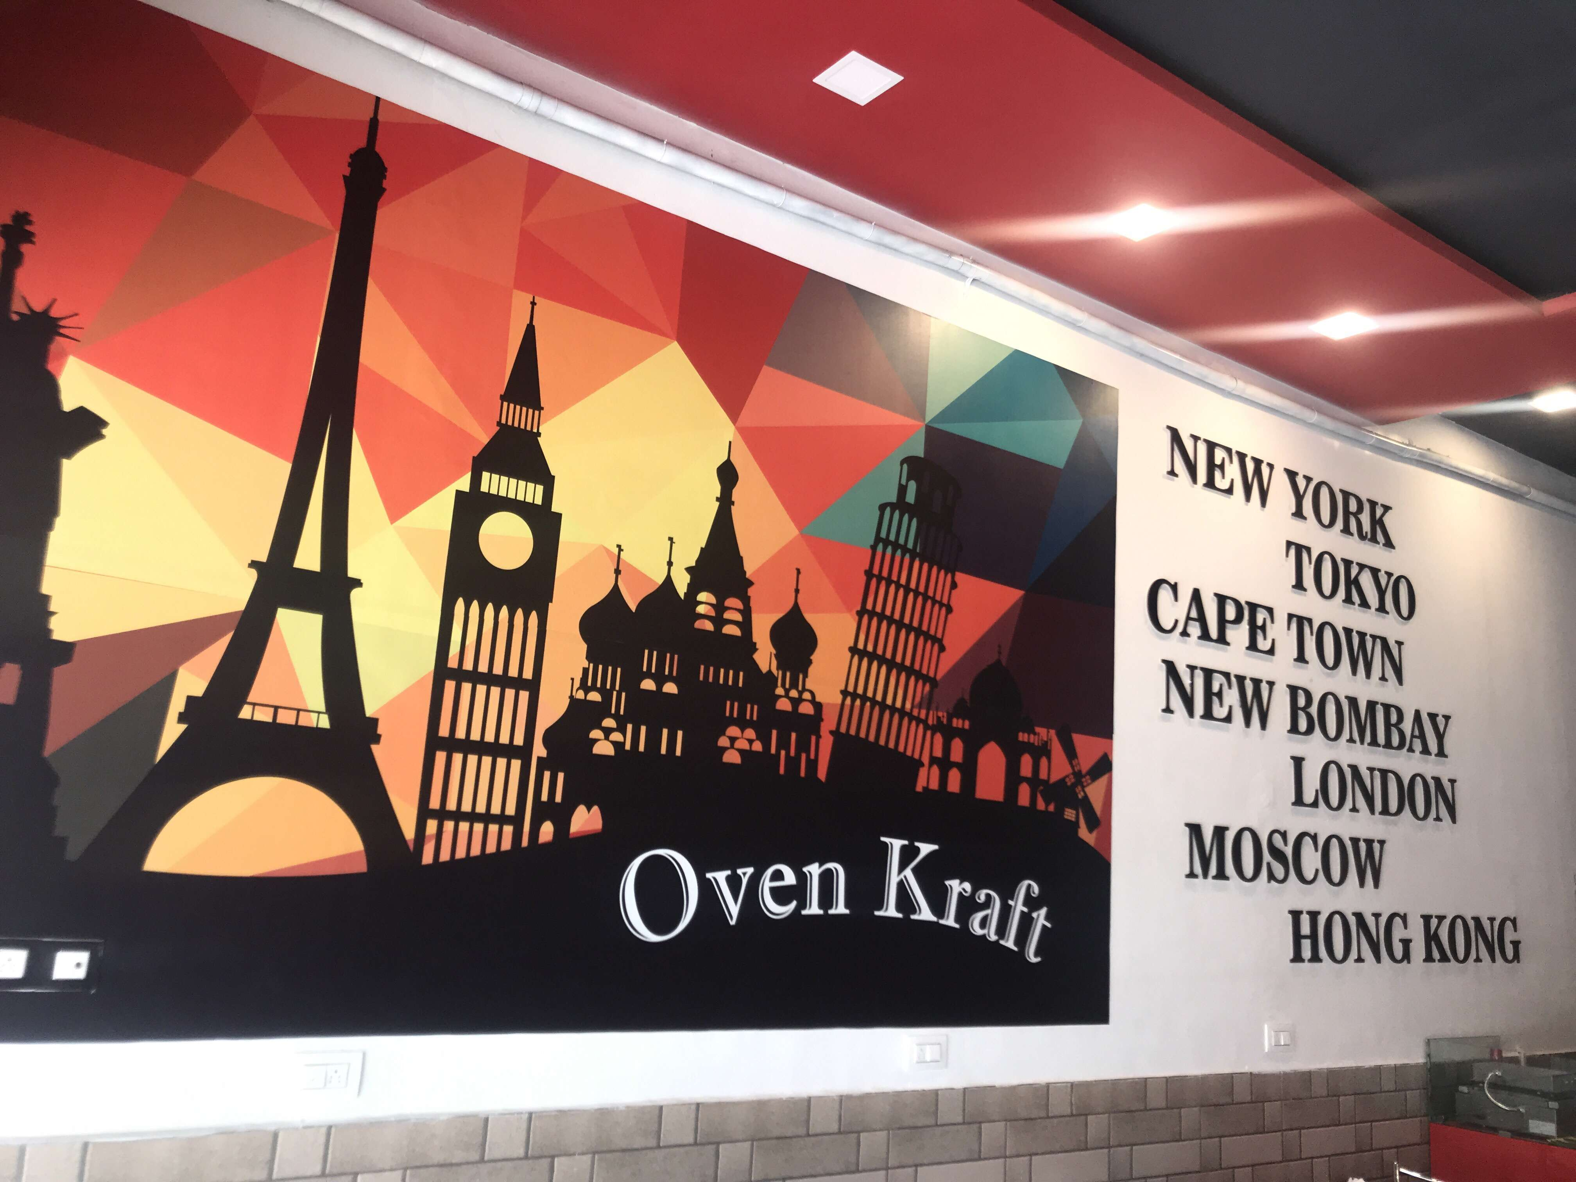
OBJECTIVE & SCOPE
To undertake complete strategy restructuring
With regards to internal structure, operations, resource management, financial management
OBJECTIVE
SCOPE
Each phase will consist of critical assessment and conclusive review
External Diagnosis
Internal Diagnosis
Strategy Formation
Financial Formation

Slide 6
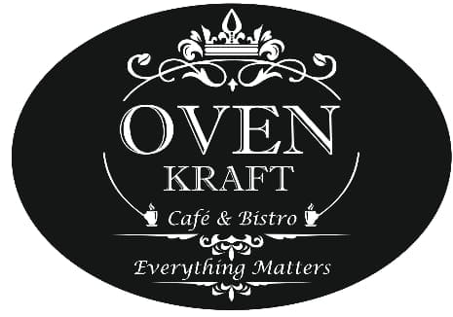
PROJECT METHODOLOGY & DELIVERABLES
Phase
Phase I
External & Internal Diagnosis
Industry assessment
Overview of the Restaurant sectors in India
Restaurant industry Trend
Identification of Growth drivers
Understanding business areas and operations
Contents
Tools
Secondary research Sources
Tableau, Google Trend and Microsoft Excel
Internal analysis of Market
Timeline
3 WEEKS

Slide 7
PROJECT METHODOLOGY & DELIVERABLES
Phase
Phase II
Strategy Formation & Financial Formation
Identifying strategies for diversification
Review of feasibility of expansion plans
Development of growth areas
Marketing strategies
SWOT analysis at the strategic level
Financial formation
Contents
Timeline
3 WEEKS

Slide 8
MARKET ANALYSIS
In India Fast-Food industry market is growing with projected growth at the rate of 18% CAGR (Compound Annual Growth Rate) during 2021 to 2025.
The Population of India is 1.3 Billion as of 2020 and 35% of the people live in urban area.
Company wants to start Business again in Navi Mumbai renowned area Kharghar
IMPORTANT KEY FIGURES
Restaurant listings in Zomato 270k
Domino's Pizza stores 1,312
Starbucks Café outlets 176 cities
FAST FOOD
Number of YUM! Brands units 50,170
MOST VISITED FAST FOOD RESTAURANT
Domino's
AVERAGE WEEKLY CONSUMPTION
1-3 times
Source: https: Businesswire, statista, Worldometer

Slide 9
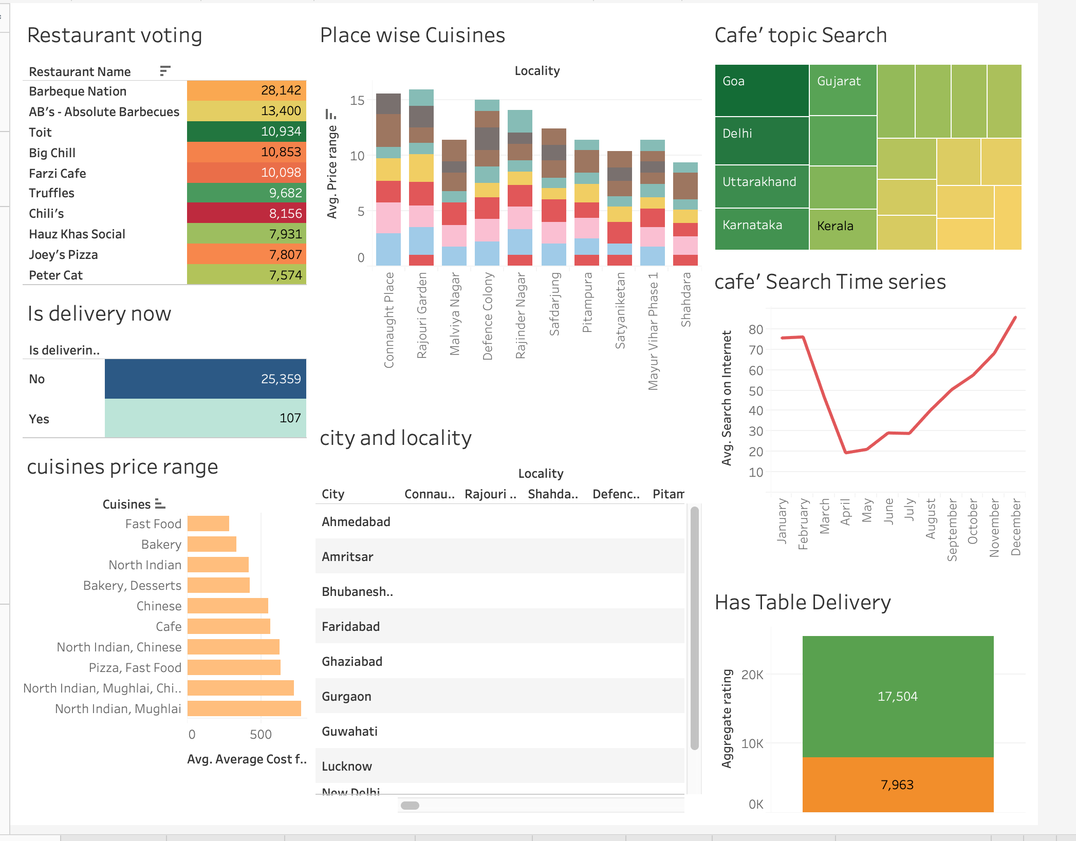
MARKET ANALYSIS

Slide 10
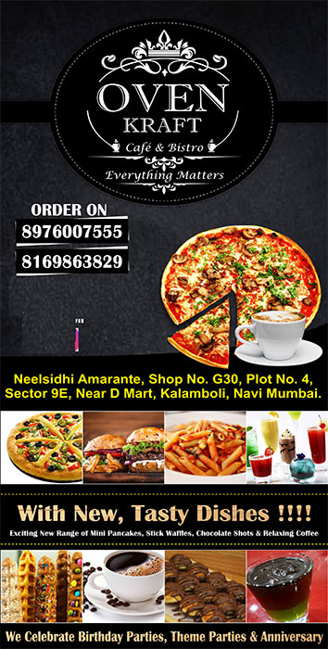
GROWTH DRIVERS
Increasing urbanization
Rapid expansion in food delivery services
Expanding young & working population
Growing number of dual-income families
Rising disposable income in the country

Slide 11
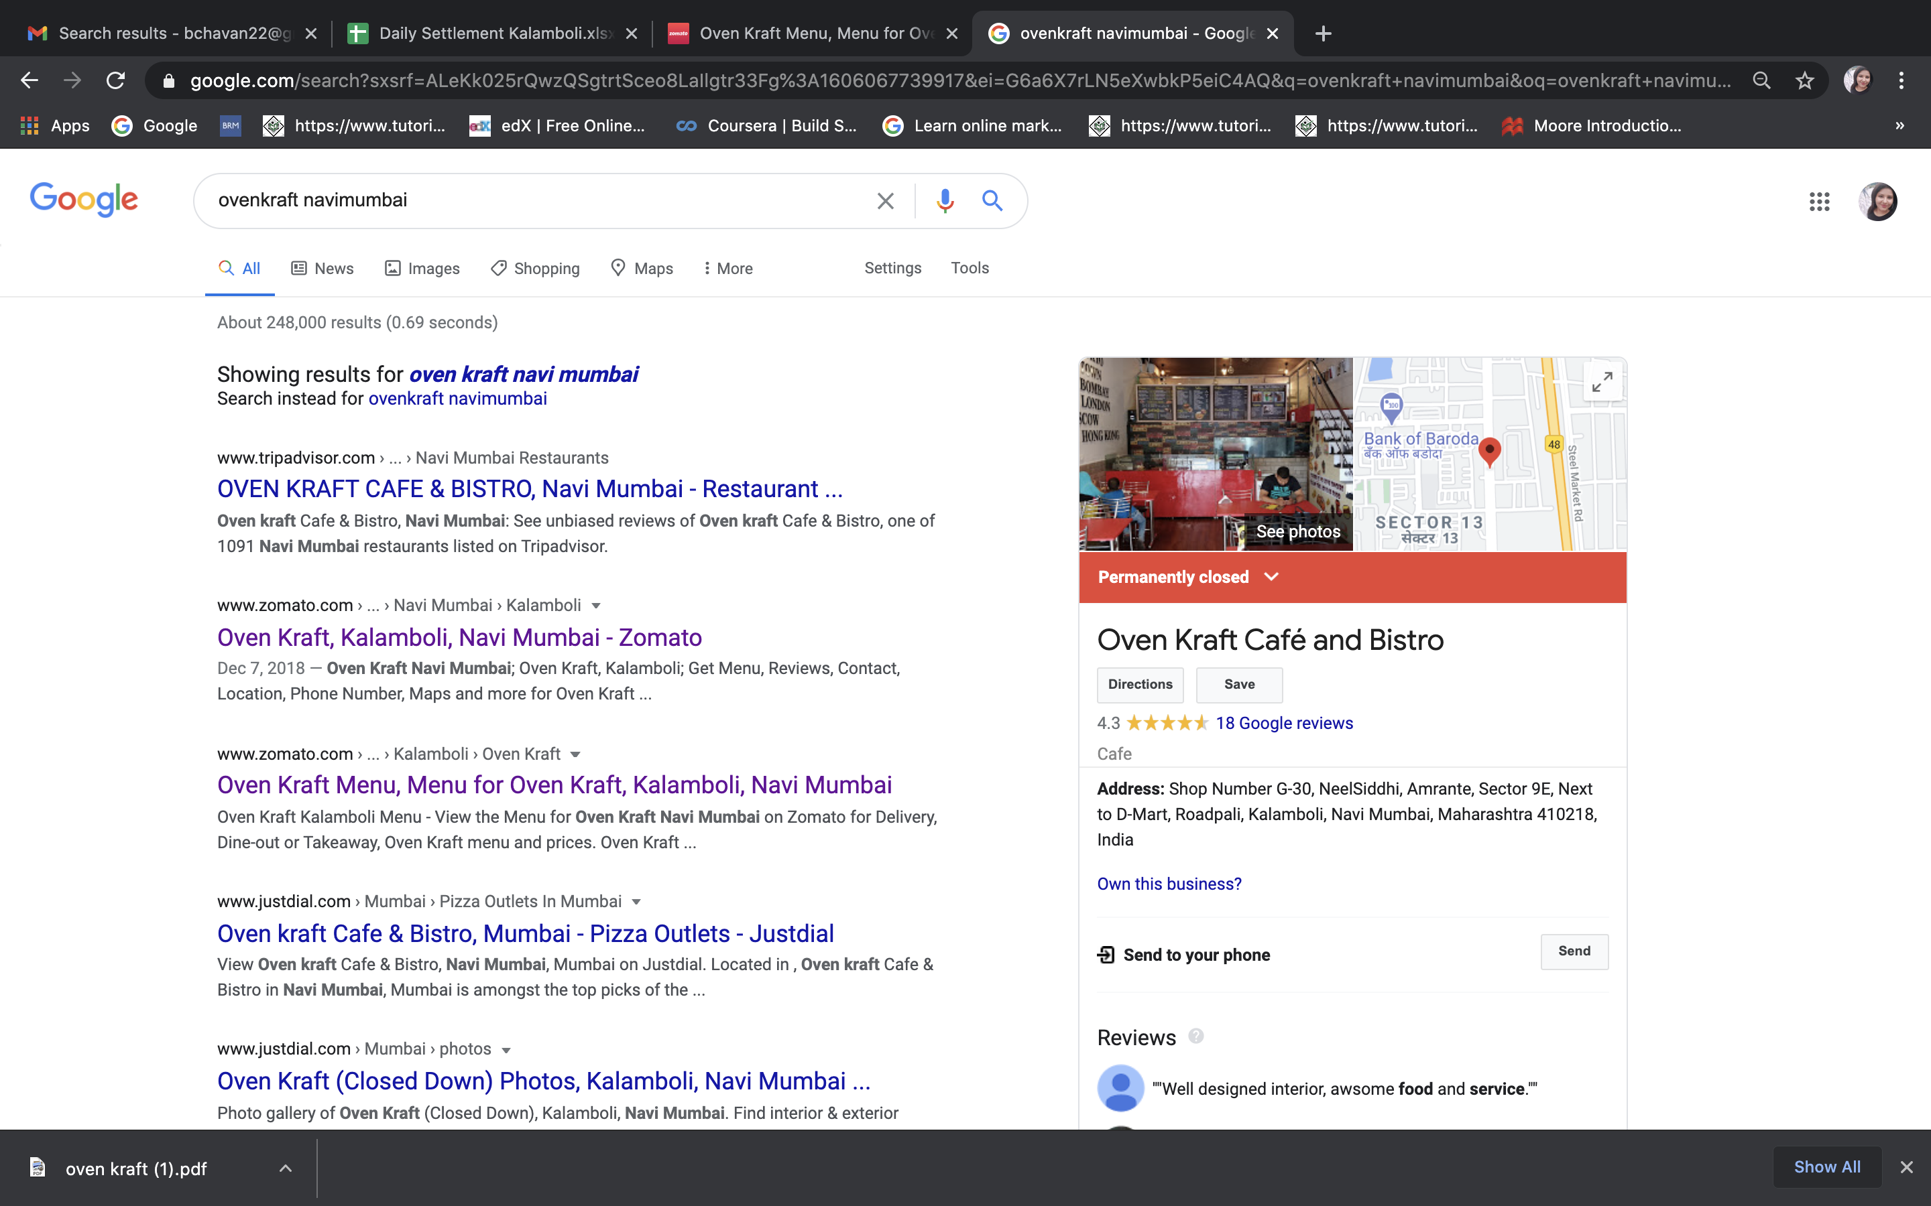
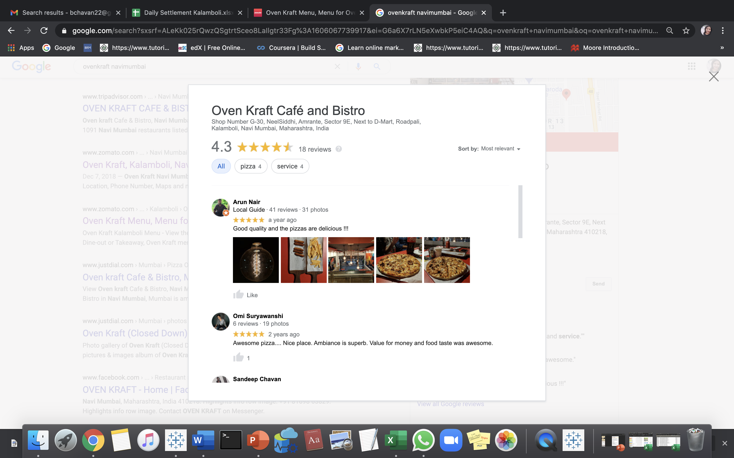
Understanding of Oven Kraft Business

Slide 12

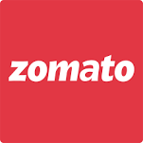



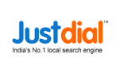
Online Presences
Google
Facebook
Instagram
Zomato
Swiggy
JustDial
TripAdvisor

Slide 13
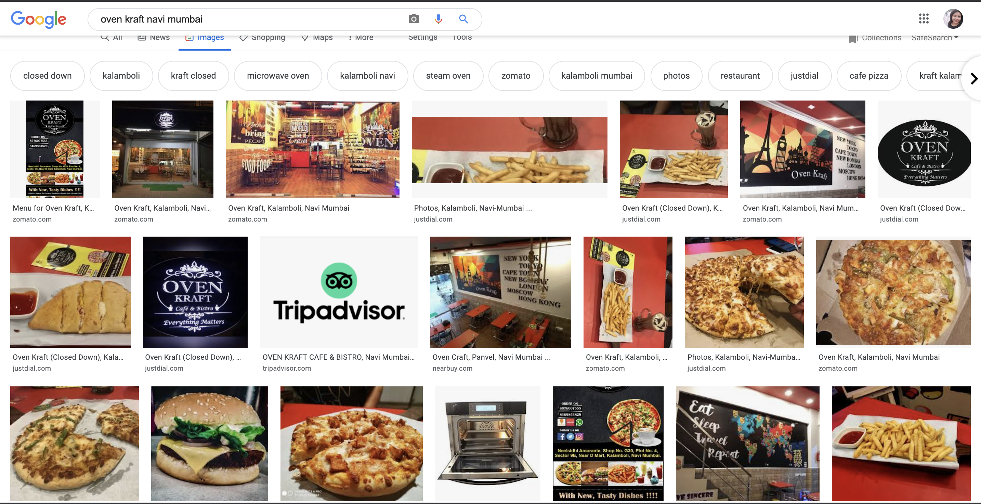
Online Presences

Slide 14
MARKETING STRATEGY FORMATION
These following are classical approach
Creating website
Blogs
Customer Reviews as text post
Customer Photos post
Café should post on website page and social media page
Use company network database to promote your services and offer them extra food discount with next order serving

Slide 15
MARKETING STRATEGY FORMATION
Different approach
Leverage social media to get more Customer
Social media Food influencer on YOU TUBE, INSTAGRAM and FACEBOOK famous personality
Instagram and more other same social media Food influencer who has quite good audience target them to market our services.
Organize events where Young generation can get more attraction towards Café Food
Track your marketing strategy
Guest blogging on other relevant sites
Getting quoted in an article (called an editorial link)
Getting local press (newspaper or website in your area)

Slide 16
COMPETITOR PROFILE
COMPANY NAME | Da Capo Café & Bistro : Best Cafe
ADDRESS | 12 & 13, Bhoomi Heights, Sector 8, Kharghar, Navi Mumbai, Maharashtra 410210, India
FACILITY | Italian, Mexican & Lebanese fast food offered in a bright, split-level cafe with French windows
TIMINGS | Monday to Sunday - 7 am To 11 pm
ORDER TYPE | Dine-in Takeout No-contact delivery Reservations: dineout.co.in, eazydiner.com
COMPANY NAME | Barista Coffee
ADDRESS | Shah Heights, Shop 14/15, Sector 7, Kharghar, Navi Mumbai, Maharashtra 410210, India
FACILITY | Served coffee and Fast Food
TIMINGS | Monday to Sunday - 8 am To 12 am(Midnight)
ORDER TYPE | Dine-in Takeout Delivery

Slide 17
Competitor Profile
COMPANY NAME | Tea Villa Cafe
ADDRESS | Mahavir Astha, Shop No. 3, 1st and 2nd floor, Near, Utsaw Chowk Perimeter Rd, Sector 7, Kharghar, Navi Mumbai, Maharashtra 410210, India
FACILITY | Served coffee and Fast Food, Indian Breakfast dishes
TIMINGS | Monday to Sunday - 10 am To 12 am (Midnight)
ORDER TYPE | Dine-in Takeout No-contact delivery
COMPANY NAME | Dhaba Café
ADDRESS | Swarna Complex, Sector-7, Kendriya Vihar Rd, Shivali Chs, Sector 7, Kharghar, Navi Mumbai, Maharashtra 410210, India
FACILITY | Served coffee and Fast Food, North Indian food cuisine
TIMINGS | Monday to Sunday - 7 am To 12 am(Midnight)
ORDER TYPE | Dine-in Takeout Delivery

Slide 18
SWOT ANALYSIS
Helpful to achieve objective
Harmful to achieve objective
Hire knowledgeable staff who are actively involved in the field.
Highest quality of service.
Result oriented approach to attracting and maintain customers.
Localise taste food
Modern and relaxing Environment
Outstanding Customer Services
Confusing Menu
Unknown brand name
Price Confusion
Price sensitive market from unorganized sector
Low efficiency booking system
Long Waiting Duration
Internal analysis
S
W
O
Health-Conscious Trend
High Exposure Location
Loyal returning customer
Every year growing population in the city
Can open more franchise
Potential sponsorship opportunity of upcoming events.
Competitor offers delivery and Takeaway
Competitor nearby locations
Cheaper price offered by other Café
Authentic food taste offered by renowned café’s
T
External analysis

Slide 19
FINANCIAL FORMATION
ESTIMATION OF PROJECT COSTING
DESCRIPTION | TOTAL COST(INR)
RESTAURANT MACHINERY(IMPORTED) | 2,50,000
UTILITIES | 400,000
COMPUTERS & SOFTWARE | 50,000
INTERIOR | 2,00,000
FURNITURE & FIXTURES | 100,000
PRE-OPERATIVE EXPENSES | 120,000
EMERGENCY COST (CONTINGENCY) (ITEM 1 TO 6) | 20,000
WORKING CAPITAL MARKETING FUND | 310,000
TOTAL | 1,000,000

Slide 20
FINANCIAL FORMATION
ESTIMATION OF REVENUE EXPENTIDURE
DESCRIPTION | TOTAL COST(INR)
EXPECTED REVENUE | 3,600,000
MARKETING | 800,000
FIXED COST (RENT) | 480,000
UTILITES | 240,000
TOTAL (EXPECTED PROFIT FOR YEAR 2021) | 2,080,000

Slide 21
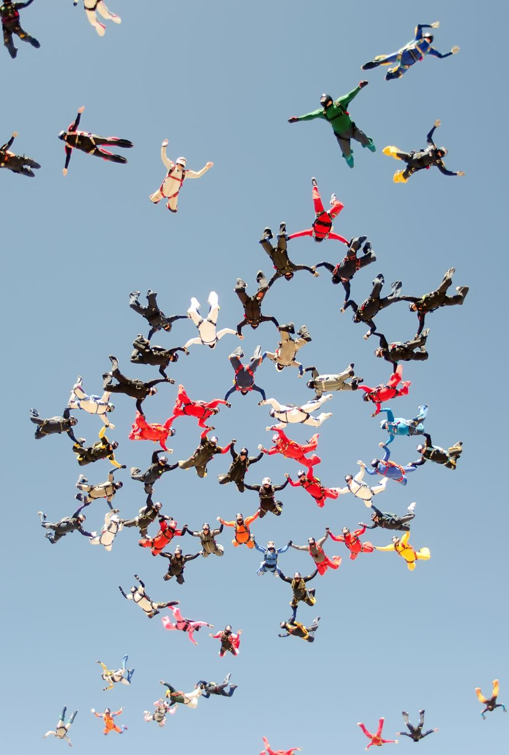
CONCLUSION AND SUGGESTIONS
It is completely feasible to enter in the market for this business
Competitors mainly posting short length videos on social media for promotion
OVEN KRAFT (OK) group should post 1 or 2 short videos per week consistently on social media for promotion
Competitor had created an episode series, where they mainly promote their activities and services, they are offering
Similarly, OK group should follow the parallel way of ideas to promote on social media such as their competitor
OK group has unique customers(active on promoting OK group social media pages), so that OK group can offer them some more deals in their following visit
OK group could send alerts(via call, text, e-mail) to their existing customers about their present activities and deals
Our competitor using same strategy for attracting customer

Slide 22
Links
https://www.businesswire.com/news/home/20200313005289/en/Quick-Service-Restaurants-Market-in-India-is-Projected-to-Grow-at-a-CAGR-Of-Over-18-During-the-Period-2021-2025---ResearchAndMarkets.com
https://www.statista.com/statistics/561263/india-average-fast-food-consumption-per-week/
https://www.worldometers.info/world-population/india-population/#:~:text=The%20current%20population%20of%20India,of%20the%20total%20world%20population.
Google search engine for image search and competitor analysis
Kaggale.com for Zomato dataset

Slide 23
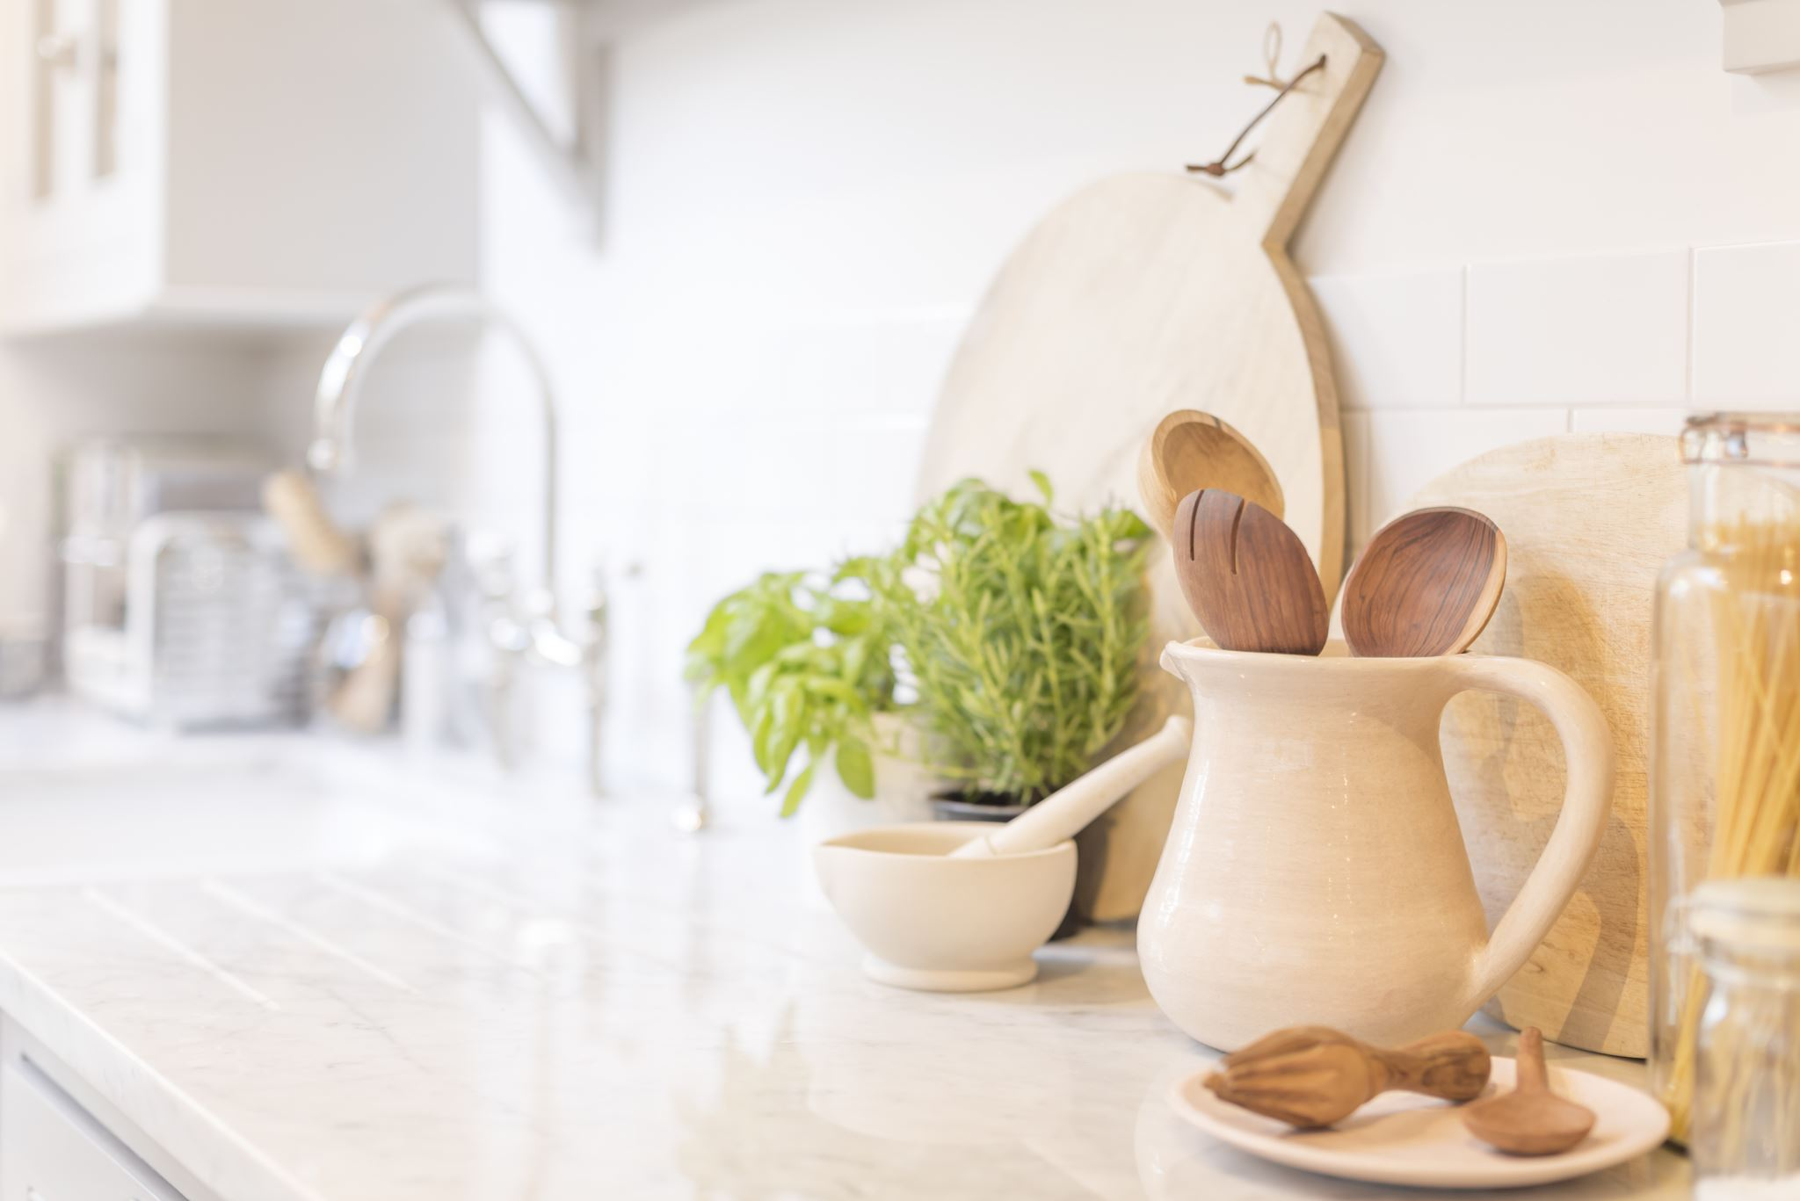
THANK YOU

